Slide 1

Predicting Thunderstorms with a Neural Network (via Python)
Group Members:
Annet John
Samarth Gowda
Pratesh Gartaula
Roneil Boodram
Pace University – CS 610 – Fall 2020 – Final Presentation

Slide 2

What is a Neural Network ?
Neural Network is best used for predictive analysis because of the hidden layers. These hidden layers help to attain accurate computation. In addition, we use Artificial Neural Networks (ANN) as predictive analysis in order to get better results, it is designed to solve problems like the way the human brain solves them. They can be used to derive functionality from clustering and classification algorithms, rendering them into larger Machine Learning Language. Examples of where neural networks are used: stock market, risk assessment, fraud detection, video game A.I., and forecasting!

Slide 3
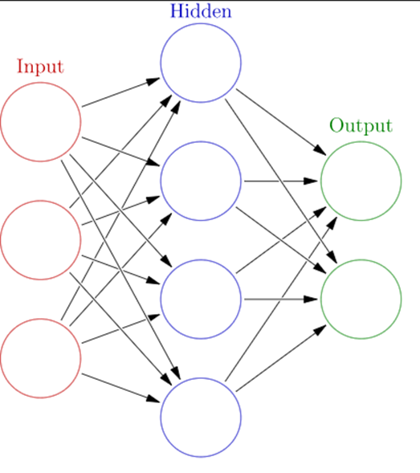
There are three layers to the structure of a neural-network algorithm:
The input layer: This enters past data values into the next layer.
2) The hidden layer: This is a key component of a neural network. It has complex functions that create predictors. A set of nodes in the hidden layer called neurons represents math functions that modify the input data.
3) The output layer: Here, the predictions made in the hidden layer are collected to produce the final layer – which is the model’s prediction, see in [2].

Slide 4
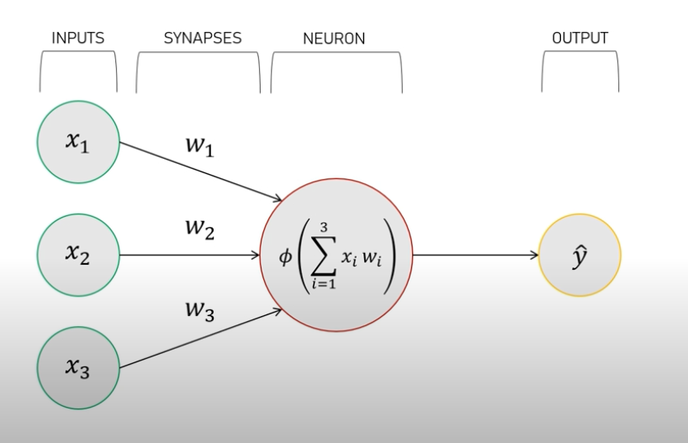
Perceptron (a machine learning algorithm)

Slide 5
Five Updates to Our Neural Network
Expanded Data Set: Now utilizing 52 weeks in our weather model, rather than just 10 weeks as shown in midterm presentation.
Expanded Numerical Range with Variables: Now utilizing 0 – 9 in our weather model, rather than just 0 and 1 (binary ranges) as shown in our midterm
Variations to synaptic weights: end-user can make variances to synaptic weights and the weather prediction model will still produce accurate results.
Expanded the amount of training iterations in our neural network – we now programed our model to have 30000 training iterations, rather than just 10000
Improved user interface – Python code includes labels RE: which input is corresponds with each weather variable (this was not present in midterm presentation).
Goal: Is our Neural Network robust, and can future programmers edit the code for their own weather models

Slide 6
Previous Data Set (Midterm)
 | High Humidity (Input 1) | High Temperature (Input 2) | Strong Wind (Input 3) | Thunderstorm
Week 1 | 0 | 0 | 1 | 0
Week 2 | 1 | 1 | 1 | 1
Week 3 | 1 | 0 | 1 | 1
Week 4 | 0 | 0 | 1 | 0
Week 5 | 0 | 0 | 1 | 0
Week 6 | 0 | 0 | 1 | 0
Week 7 | 1 | 1 | 1 | 1
Week 8 | 1 | 0 | 1 | 1
Week 9 | 0 | 1 | 1 | 0
Week 10 | 1 | 0 | 0 | ?
Goal: Determine if there will be a thunderstorm on Week 10 via our Neural Network
1 = TRUE
0 = FALSE

Slide 7
Current Data Set (Final)
52 weeks instead of 10 weeks.
Weather variables can now range from 0 – 9, rather than just 1 or 0 as shown in our midterm.
Current Data Set (Final)
 | High Temperature | High Humidity | Strong Wind | Thunderstorm
Week 1 | 0 | 2 | 1 | 0
Week 2 | 1 | 5 | 1 | 1
Week 3 | 1 | 7 | 6 | 1
Week 4 | 0 | 4 | 1 | 0
Week 5 | 0 | 6 | 5 | 0
Week 6 | 0 | 9 | 1 | 0
Week 7 | 1 | 1 | 1 | 1
Week 8 | 1 | 0 | 1 | 1
Week 9 | 0 | 1 | 1 | 0
Week 10 | 1 | 0 | 8 | 1
Week 11 | 0 | 4 | 1 | 0
Week 12 | 1 | 1 | 4 | 1
Week 13 | 1 | 0 | 1 | 1
Week 14 | 0 | 3 | 1 | 0
Week 15 | 0 | 0 | 4 | 0
Week 16 | 0 | 7 | 1 | 0
Week 17 | 1 | 1 | 1 | 1
Week 18 | 1 | 0 | 2 | 1
Week 19 | 0 | 6 | 3 | 0
Week 20 | 1 | 0 | 0 | 1
Week 21 | 0 | 0 | 1 | 0
Week 22 | 1 | 1 | 5 | 1
Week 23 | 1 | 0 | 1 | 1
Week 24 | 0 | 0 | 1 | 0
Week 25 | 1 | 5 | 1 | 1
Week 26 | 0 | 6 | 9 | 0
Week 27 | 1 | 1 | 1 | 1
Week 28 | 1 | 2 | 1 | 1
Week 29 | 0 | 1 | 9 | 0
Week 30 | 1 | 4 | 0 | 1
Week 31 | 0 | 0 | 8 | 0
Week 32 | 1 | 1 | 9 | 1
Week 33 | 1 | 6 | 6 | 1
Week 34 | 0 | 0 | 1 | 0
Week 35 | 0 | 7 | 6 | 1
Week 36 | 0 | 0 | 1 | 0
Week 37 | 1 | 1 | 1 | 1
Week 38 | 1 | 8 | 1 | 1
Week 39 | 0 | 1 | 1 | 0
Week 40 | 1 | 0 | 0 | 1
Week 41 | 1 | 4 | 1 | 1
Week 42 | 0 | 5 | 1 | 0
Week 43 | 1 | 1 | 1 | 1
Week 44 | 1 | 2 | 8 | 1
Week 45 | 0 | 0 | 1 | 0
Week 46 | 0 | 0 | 1 | 1
Week 47 | 0 | 3 | 1 | 0
Week 48 | 1 | 4 | 1 | 1
Week 49 | 1 | 0 | 1 | 1
Week 50 | 0 | 1 | 1 | 0
Week 51 | 1 | 8 | 9 | 1
Week 52 | 1 | 0 | 0 | ?

Slide 8
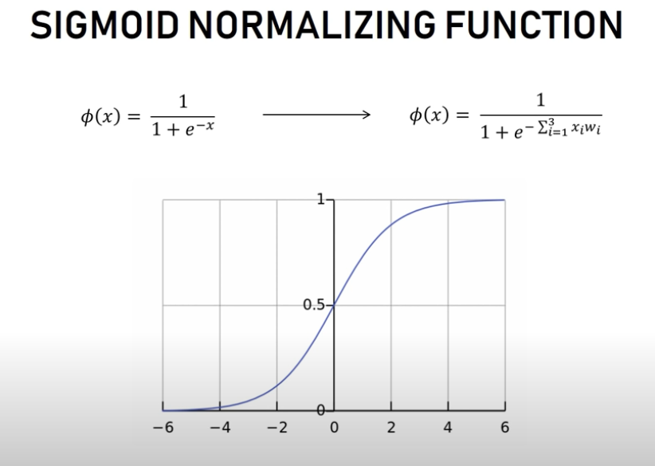
Sigmoid Function (Midterm)

Slide 9
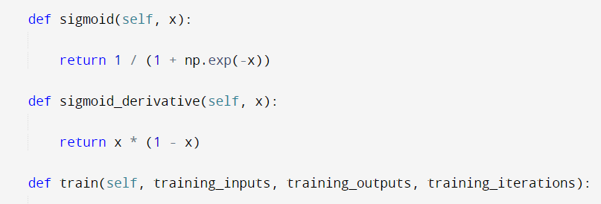
Sigmoid Function (Final)
Must keep sigmoid function, since our outputs will be displayed as 0 or 1 (0 = no thunderstorm, 1 = there will be a thunderstorm

Slide 10
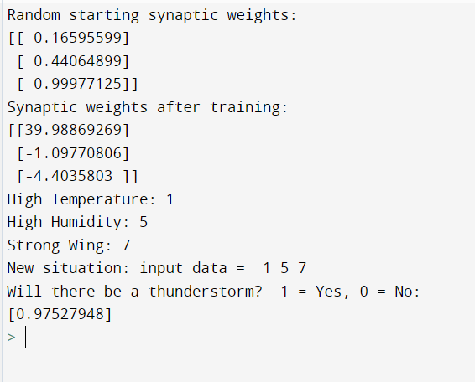
Synaptic Weights (Midterm)

Slide 11
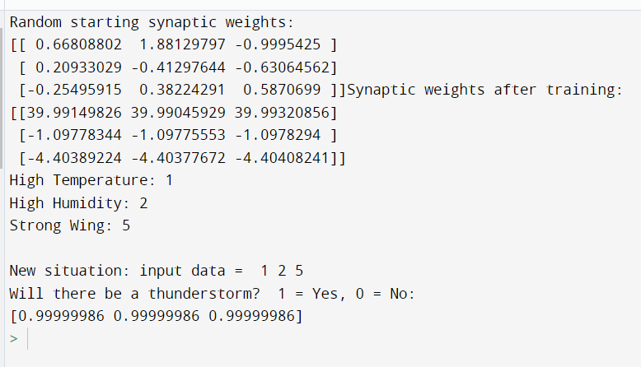
Synaptic Weights (Final)

Slide 12
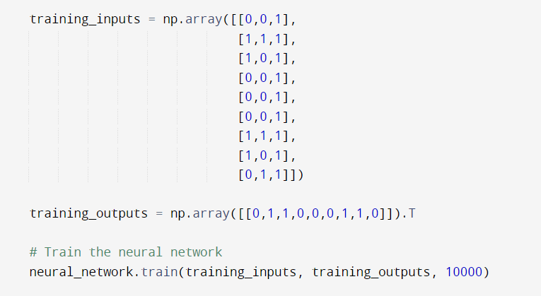
Training the Neural Network (Midterm = 10,000 iterations)

Slide 13
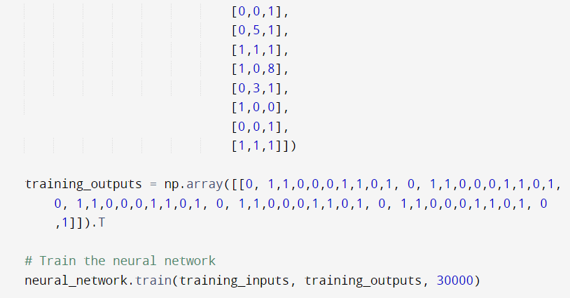
Training the Neural Network (Final = 30,000 iterations)

Slide 14
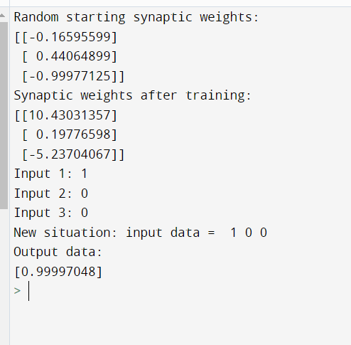
Receiving Outputs (Midterm)

Slide 15
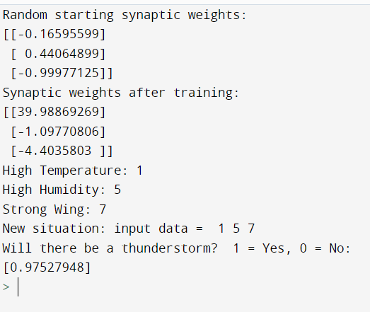
Receiving Outputs (Final)
Improved user interface with clear instructions and outputs RE: weather model predictions

Slide 16
Five Updates to Our Neural Network
Expanded Data Set: Now utilizing 52 weeks in our weather model, rather than just 10 weeks as shown in midterm presentation.
Expanded Numerical Range with Variables: Now utilizing 0 – 9 in our weather model, rather than just 0 and 1 (binary ranges) as shown in our midterm
Variations to synaptic weights: end-user can make variances to synaptic weights and the weather prediction model will still produce accurate results.
Expanded the amount of training iterations in our neural network – we now programed our model to have 30000 training iterations, rather than just 10000
Improved user interface – Python code includes labels RE: which input is corresponds with each weather variable (this was not present in midterm presentation).
Goal: Is our Neural Network robust, and can future programmers edit the code for their own weather models

Slide 17
How to Run the Code
Download Python: https://www.python.org/downloads/
Install Python
Install Numpy (this allows a neural network to be trained) : pip install numpy
Run Code (see attached document)
Enter Inputs shown in Week 52
Receive output

Slide 18
References: [1] Andrew Culclasure, “Using Neural Networks to provide local weather forecasts”, Spring 2013. [2] Team EA, “Prediction using neural networks”. https://expressanalytics.com/, February 2020. [3] Glosser.ca, CC BY-SA 3.0, “Artificial neural network with layer coloring”. https://commons.wikimedia.org/wiki/File:Colored_neural_network.svg, 28 February 2013, https://upload.wikimedia.org/wikipedia/commons/4/46/Colored_neural_network.svg

